Slide 1
Week 04
Jonathan Chen 陳畯田

Slide 2

Exceptions
一直 error
先不管它

Slide 3
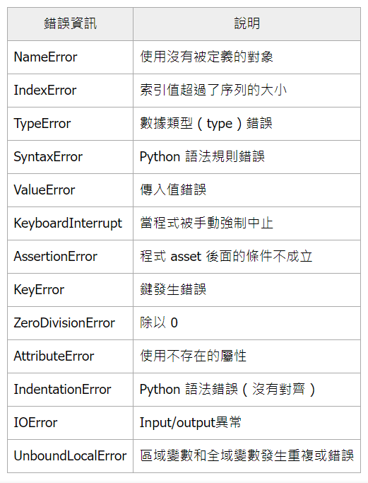

Slide 4
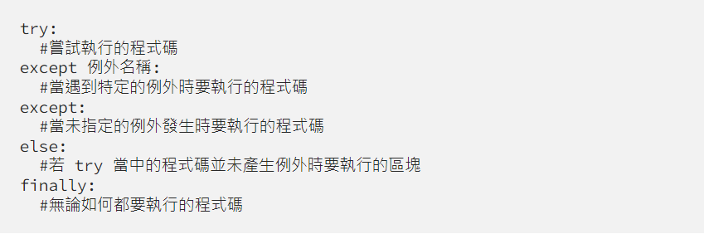

Slide 5
Loops
for
range()
while
break
continue
pass

Slide 6
String Operation
Operators
‘’’________’’’
in/not in
lower()、upper()、title()、capitalize()
islower()、isupper()
startswith()、endswith()
split()、replace()
index : []

Slide 7
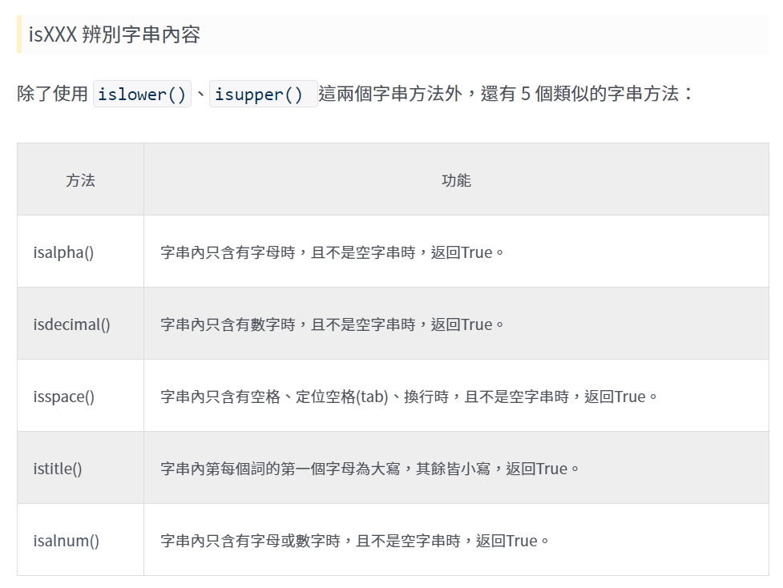

Slide 8
String Operation
https://selflearningsuccess.com/pythonstring/

Slide 9
List Operation
index : []
list.append(object)
list.insert(position, object)
list.extend()
list.remove(object)
list.pop()
list.sort(reverse=True/False)
sorted_list = sorted(list_name)
list.reverse()
max()/min()
sum()
join()

Slide 10
List Comprehension
list = [x for x in range(0,10)]

Slide 11
Function-Why
重複利用性
易讀性
易除錯性
一致性
模組化

Slide 12

Function-When

Slide 13
File
with open
mode
encoding
read()、readline()
write()

